Slide 1
CS 5513 Computer Architecture
Lecture 4 – Memory Hierarchy Review

Slide 2
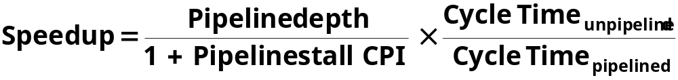
Review from last lecture
Quantify and summarize performance
  Ratios, Geometric Mean, Multiplicative Standard Deviation
F&P: Benchmarks age, disks fail,1 point fail danger
Control VIA State Machines and Microprogramming
Just overlap tasks; easy if tasks are independent
Speed Up ≤ Pipeline Depth; if ideal CPI is 1, then:
Hazards limit performance on computers:
  Structural: need more HW resources
  Data (RAW,WAR,WAW): need forwarding, compiler scheduling
  Control: delayed branch, prediction
Exceptions, Interrupts add complexity

Slide 3
Outline
Review
Memory hierarchy
Locality
Cache design
Virtual address spaces
Page table layout
TLB design options
Conclusion

Slide 4
Memory Hierarchy Review

Slide 5
Since 1980, CPU has outpaced DRAM ...
Q. How do architects address this gap?
A. Put smaller, faster “cache” memories between CPU and DRAM.
Create a “memory hierarchy”.
Performance
(1/latency)
CPU
60% per yr
2X in 1.5 yrs
1000
CPU
100
Gap grew 50% per year
10
DRAM
9% per yr
2X in 10 yrs
DRAM
1980
1990
2000
Year

Slide 6

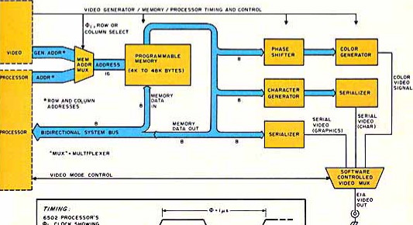
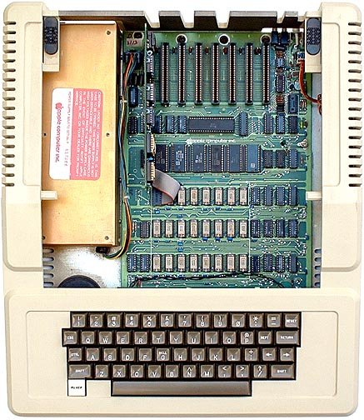


1977: DRAM faster than microprocessors
Apple ][ (1977)
CPU: 1000 ns
DRAM: 400 ns
Steve
Wozniak
Steve Jobs

Slide 7
Levels of the Memory Hierarchy
Capacity
Access Time
Cost
Upper Level
Staging
Xfer Unit
faster
CPU Registers
100s Bytes
<10s ns
Registers
Instr. Operands
prog./compiler
1-8 bytes
Cache
K Bytes
10-100 ns
1-0.1 cents/bit
Cache
Blocks
cache cntl
8-128 bytes
Main Memory
M Bytes
200ns- 500ns
$.0001-.00001 cents /bit
Memory
Pages
OS
512-4K bytes
Disk
G Bytes, 10 ms
(10,000,000 ns)
10 - 10 cents/bit
Disk
-5
-6
Files
user/operator
Mbytes
Tape
infinite
sec-min
10
Larger
Tape
Lower Level
-8

Slide 8


Memory Hierarchy: Apple iMac G5
Managed
by compiler
Managed
by hardware
Managed by OS,
hardware,
application
07 | Reg | L1 Inst | L1 Data | L2 | DRAM | Disk
Size | 1K | 64K | 32K | 512K | 256M | 80G
Latency Cycles, Time | 1, 0.6 ns | 3, 1.9 ns | 3, 1.9 ns | 11, 6.9 ns | 88, 55 ns | 10⁷, 12 ms
iMac G5
1.6 GHz
Goal: Illusion of large, fast, cheap memory
Let programs address a memory space that scales to the disk size, at a speed that is usually as fast as register access

Slide 9
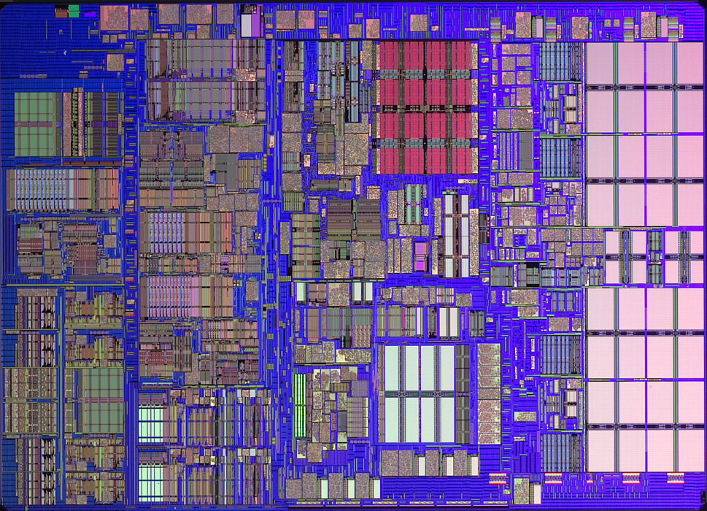
iMac’s PowerPC 970: All caches on-chip
L1 (64K Instruction)
Registers
512K
L2
(1K)
L1 (32K Data)

Slide 10
The Principle of Locality
The Principle of Locality:
  Program access a relatively small portion of the address space at any instant of time.
Two Different Types of Locality:
  Temporal Locality (Locality in Time): If an item is referenced, it will tend to be referenced again soon (e.g., loops, reuse)
  Spatial Locality (Locality in Space): If an item is referenced, items whose addresses are close by tend to be referenced soon
  (e.g., straightline code, array access)
Last 15 years, HW relied on locality for speed
It is a property of programs which is exploited in machine design.
Notes:
The principle of locality states that programs access a relatively small portion of the address space at any instant of time.
This is kind of like in real life, we all have a lot of friends. But at any given time most of us can only keep in touch with a small group of them.
There are two different types of locality: Temporal and Spatial. Temporal locality is the locality in time which says if an item is referenced, it will tend to be referenced again soon.
This is like saying if you just talk to one of your friends, it is likely that you will talk to him or her again soon.
This makes sense. For example, if you just have lunch with a friend, you may say, let’s go to the ball game this Sunday. So you will talk to him again soon.
Spatial locality is the locality in space. It says if an item is referenced, items whose addresses are close by tend to be referenced soon.
Once again, using our analogy. We can usually divide our friends into groups. Like friends from high school, friends from work, friends from home.
Let’s say you just talk to one of your friends from high school and she may say something like: “So did you hear so and so just won the lottery.”
You probably will say NO, I better give him a call and find out more.
So this is an example of spatial locality. You just talked to a friend from your high school days. As a result, you end up talking to another high school friend. Or at least in this case, you hope he still remember you are his friend.
+3 = 10 min. (X:50)

Slide 11
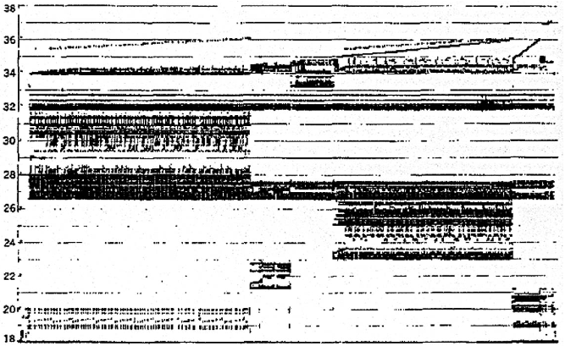
Programs with locality cache well ...
Bad locality behavior
Temporal
Locality
Memory Address (one dot per access)
Spatial
Locality
Time
Donald J. Hatfield, Jeanette Gerald: Program Restructuring for Virtual Memory. IBM Systems Journal 10(3): 168-192 (1971)

Slide 12
Memory Hierarchy: Terminology
Hit: data appears in some block in the upper level (example: Block X)
  Hit Rate: the fraction of memory access found in the upper level
  Hit Time: Time to access the upper level which consists of
    RAM access time + Time to determine hit/miss
Miss: data needs to be retrieve from a block in the lower level (Block Y)
  Miss Rate = 1 - (Hit Rate)
  Miss Penalty: Time to replace a block in the upper level +
    Time to deliver the block the processor
Hit Time << Miss Penalty (500 instructions on 21264!)
Lower Level
Memory
To Processor
Upper Level
Memory
Blk X
From Processor
Blk Y
Notes:
A HIT is when the data the processor wants to access is found in the upper level (Blk X).
The fraction of the memory access that are HIT is defined as HIT rate.
HIT Time is the time to access the Upper Level where the data is found (X). It consists of:
(a) Time to access this level.
(b) AND the time to determine if this is a Hit or Miss.
If the data the processor wants cannot be found in the Upper level. Then we have a miss and we need to retrieve the data (Blk Y) from the lower level.
By definition (definition of Hit: Fraction), the miss rate is just 1 minus the hit rate.
This miss penalty also consists of two parts:
(a) The time it takes to replace a block (Blk Y to BlkX) in the upper level.
(b) And then the time it takes to deliver this new block to the processor.
It is very important that your Hit Time to be much much smaller than your miss penalty. Otherwise, there will be no reason to build a memory hierarchy.
+2 = 14 min. (X:54)

Slide 13
Cache Measures
Hit rate: fraction found in that level
  So high that usually talk about Miss rate
  Miss rate fallacy: as MIPS to CPU performance,
  miss rate to average memory access time in memory
Average memory-access time
= Hit time + Miss rate x Miss penalty
(ns or clocks)
Miss penalty: time to replace a block from lower level, including time to replace in CPU
  access time: time to lower level
  = f(latency to lower level)
  transfer time: time to transfer block
  =f(BW between upper & lower levels)

Slide 14
4 Questions for Memory Hierarchy
Q1: Where can a block be placed in the upper level? (Block placement)
Q2: How is a block found if it is in the upper level?
(Block identification)
Q3: Which block should be replaced on a miss?
(Block replacement)
Q4: What happens on a write?
(Write strategy)

Slide 15
Q1: Where can a block be placed in the upper level?
Block 12 placed in 8 block cache:
  Fully associative, direct mapped, 2-way set associative
  S.A. Mapping = Block Number Modulo Number Sets
Direct Mapped
(12 mod 8) = 4
2-Way Assoc
(12 mod 4) = 0
Full Mapped
01234567
01234567
01234567
Cache
1111111111222222222233
01234567890123456789012345678901
Memory

Slide 16
Q2: How is a block found if it is in the upper level?
Tag on each block
  No need to check index or block offset
Increasing associativity shrinks index, expands tag
Block Address
Block
Offset
Tag
Index

Slide 17
Q3: Which block should be replaced on a miss?
Easy for Direct Mapped
Set Associative or Fully Associative:
  Random
  LRU (Least Recently Used)
Assoc: 2-way 4-way 8-way
Size LRU Ran LRU Ran LRU Ran
16 KB 5.2% 5.7% 4.7% 5.3% 4.4% 5.0%
64 KB 1.9% 2.0% 1.5% 1.7% 1.4% 1.5%
256 KB 1.15% 1.17% 1.13% 1.13% 1.12% 1.12%

Slide 18
Q3: After a cache read miss, if there are no empty cache blocks, which block should be removed from the cache?
The Least Recently Used (LRU) block? Appealing,
but hard to implement for high associativity
A randomly chosen block?
Easy to implement, how
well does it work?
Miss Rate for 2-way Set Associative Cache
 | Size | Random | LRU
 | 16 KB | 5.7% | 5.2%
 | 64 KB | 2.0% | 1.9%
 | 256 KB | 1.17% | 1.15%
Also,
try
other
LRU
approx.

Slide 19
Q4: What happens on a write?
 | Write-Through | Write-Back
Policy | Data written to cache block also written to lower-level memory | Write data only to the cache Update lower level when a block falls out of the cache
Debug | Easy | Hard
Do read misses produce writes? | No | Yes
Do repeated writes make it to lower level? | Yes | No
Additional option -- let writes to an un-cached address allocate a new cache line (“write-allocate”).

Slide 20
Write Buffers for Write-Through Caches
Cache
Lower Level Memory
Processor
Write Buffer
Holds data awaiting write-through to
lower level memory
Q. Why a write buffer ?
A. So CPU doesn’t stall
Q. Why a buffer, why not just one register ?
A. Bursts of writes are
common.
Q. Are Read After Write (RAW) hazards an issue for write buffer?
A. Yes! Drain buffer before next read, or send read 1st after check write buffers.

Slide 21
5 Basic Cache Optimizations
Reducing Miss Rate
Larger Block size (compulsory misses)
Larger Cache size (capacity misses)
Higher Associativity (conflict misses)
Reducing Miss Penalty
Multilevel Caches
Reducing hit time
Giving Reads Priority over Writes
  E.g., Read complete before earlier writes in write buffer

Slide 22
Outline
Review
Memory hierarchy
Locality
Cache design
Virtual address spaces
Page table layout
TLB design options
Conclusion

Slide 23
The Limits of Physical Addressing
“Physical addresses” of memory locations
A0-A31
A0-A31
CPU
Memory
D0-D31
D0-D31
Data
All programs share one address space:
The physical address space
Machine language programs must be
aware of the machine organization
No way to prevent a program from accessing any machine resource

Slide 24
Solution: Add a Layer of Indirection
“Virtual Addresses”
“Physical Addresses”
A0-A31
Virtual
Physical
A0-A31
CPU
Address
Translation
Memory
D0-D31
D0-D31
Data
User programs run in an standardized
virtual address space
Address Translation hardware
managed by the operating system (OS)
maps virtual address to physical memory
Hardware supports “modern” OS features:
Protection, Translation, Sharing

Slide 25
Three Advantages of Virtual Memory
Translation:
  Program can be given consistent view of memory, even though physical memory is scrambled
  Makes multithreading reasonable (now used a lot!)
  Only the most important part of program (“Working Set”) must be in physical memory.
  Contiguous structures (like stacks) use only as much physical memory as necessary yet still grow later.
Protection:
  Different threads (or processes) protected from each other.
  Different pages can be given special behavior
    (Read Only, Invisible to user programs, etc).
  Kernel data protected from User programs
  Very important for protection from malicious programs
Sharing:
  Can map same physical page to multiple users
  (“Shared memory”)

Slide 26
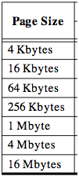
Page tables encode virtual address spaces
A virtual address space
is divided into blocks
of memory called pages
Virtual
Address Space
Physical
Address Space
frame
frame
A machine usually supports
pages of a few sizes
(MIPS R4000):
frame
frame
A valid page table entry codes physical memory “frame” address for the page

Slide 27
Page tables encode virtual address spaces
Page Table
Physical
Memory Space
A virtual address space
is divided into blocks
of memory called pages
frame
frame
frame
frame
A machine usually supports
pages of a few sizes
(MIPS R4000):
virtual address
OS manages the page table for each ASID
A page table is indexed by a
virtual address
A valid page table entry codes physical memory “frame” address for the page

Slide 28
Details of Page Table
Page Table
Physical
Memory Space
Virtual Address
frame
12
frame
V page no.
offset
frame
frame
Page Table
Page Table
Base Reg
V
Access
Rights
PA
index
into
page
table
virtual address
table located
in physical
memory
P page no.
offset
12
Physical Address
Page table maps virtual page numbers to physical frames (“PTE” = Page Table Entry)
Virtual memory => treat memory ≈ cache for disk

Slide 29
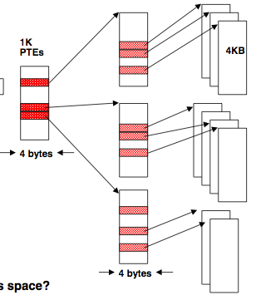
Page tables may not fit in memory!
A table for 4KB pages for a 32-bit address space has 1M entries
Each process needs its own address space!
Two-level Page Tables
32 bit virtual address
31
22
21
12
11
0
P1 index
P2 index
Page Offset
Top-level table wired in main memory
Subset of 1024 second-level tables in main memory; rest are on disk or unallocated

Slide 30
VM and Disk: Page replacement policy
Page Table
Dirty bit: page written.
Used bit: set to
1 on any reference
dirty
used
1 0
...
1 0
0 1
1 1
0 0
Set of all pages
in Memory
Tail pointer:
Clear the used
bit in the
page table
Head pointer
Place pages on free list if used bit
is still clear.
Schedule pages with dirty bit set to
be written to disk.
Freelist
Architect’s role: support setting dirty and used bits
Free Pages

Slide 31
TLB Design Concepts

Slide 32
MIPS Address Translation: How does it work?
“Virtual Addresses”
“Physical Addresses”
A0-A31
Virtual
Physical
A0-A31
Translation
Look-Aside
Buffer
(TLB)
CPU
Memory
D0-D31
D0-D31
Data
What is the table of
mappings that it caches?
Translation Look-Aside Buffer (TLB)
A small fully-associative cache of
mappings from virtual to physical addresses
TLB also contains
protection bits for virtual address
Fast common case: Virtual address is in TLB,
process has permission to read/write it.

Slide 33
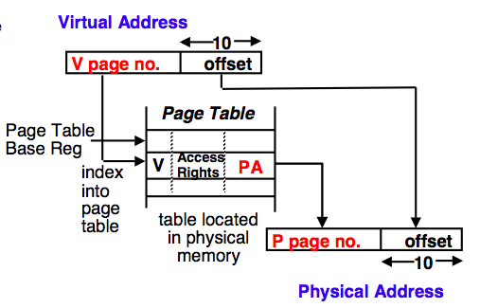
The TLB caches page table entries
Physical and virtual pages must be the same size!
TLB caches page table entries.
Physical
frame
address
virtual address
for ASID
page
off
Page Table
2
0
1
3
V=0 pages either reside on disk or have not yet been allocated.
OS handles V=0
“Page fault”
physical address
TLB
page
off
frame
page
MIPS handles TLB misses in software (random replacement). Other machines use hardware.
2
2
0
5

Slide 34
Can TLB and caching be overlapped?
Virtual Page Number | Page Offset
 |  |  | Index |  | Byte Select
 | Cache Tags |  |  |  |  |  | Cache Data
 |  |  |  |  |  |  |  | Cache Block
 |  |  |  |  |  |  |  | Cache Block
Virtual
Translation
Look-Aside
Buffer
(TLB)
Physical
Cache Tag
=
Hit
This works, but ...
Q. What is the downside?
A. Inflexibility. Size of cache limited by page size.
Data out

Slide 35
Problems With Overlapped TLB Access
Overlapped access only works as long as the address bits used to
index into the cache do not change as the result of VA translation
This usually limits things to small caches, large page sizes, or high
n-way set associative caches if you want a large cache
Example: suppose everything the same except that the cache is
increased to 8 K bytes instead of 4 K:
11
2
cache
index
00
This bit is changed
by VA translation, but
is needed for cache
lookup
20
12
virt page #
disp
Solutions:
go to 8K byte page sizes;
go to 2 way set associative cache; or
SW guarantee VA[13]=PA[13]
1K
2 way set assoc cache
10
4
4

Slide 36
Use virtual addresses for cache?
“Virtual Addresses”
“Physical Addresses”
A0-A31
Virtual
Physical
A0-A31
Virtual
Translation
Look-Aside
Buffer
(TLB)
CPU
Cache
Main Memory
D0-D31
D0-D31
D0-D31
Only use TLB on a cache miss !
Downside: a subtle, fatal problem. What is it?
A. Synonym problem. If two address spaces share a physical frame, data may be in cache twice. Maintaining consistency is a nightmare.

Slide 37
Summary #1/3:
The Cache Design Space
Several interacting dimensions
  cache size
  block size
  associativity
  replacement policy
  write-through vs write-back
  write allocation
The optimal choice is a compromise
  depends on access characteristics
    workload
    use (I-cache, D-cache, TLB)
  depends on technology / cost
Simplicity often wins
Cache Size
Associativity
Block Size
Bad
Good
Factor A
Factor B
Less
More
Notes:
No fancy replacement policy is needed for the direct mapped cache.
As a matter of fact, that is what cause direct mapped trouble to begin with: only one place to go in the cache--causes conflict misses.
No fancy replacement policy is needed for the direct mapped cache.
As a matter of fact, that is what cause direct mapped trouble to begin with: only one place to go in the cache--causes conflict misses.
Besides working at Sun, I also teach people how to fly whenever I have time.
Statistic have shown that if a pilot crashed after an engine failure, he or she is more likely to get killed in a multi-engine light airplane than a single engine airplane.
The joke among us flight instructors is that: sure, when the engine quit in a single engine stops, you have one option: sooner or later, you land. Probably sooner.
But in a multi-engine airplane with one engine stops, you have a lot of options. It is the need to make a decision that kills those people.

Slide 38
Summary #2/3: Caches
The Principle of Locality:
  Program access a relatively small portion of the address space at any instant of time.
    Temporal Locality: Locality in Time
    Spatial Locality: Locality in Space
Three Major Categories of Cache Misses:
  Compulsory Misses: sad facts of life. Example: cold start misses.
  Capacity Misses: increase cache size
  Conflict Misses: increase cache size and/or associativity.
  Nightmare Scenario: ping pong effect!
Write Policy: Write Through vs. Write Back
Today CPU time is a function of (ops, cache misses) vs. just f(ops): affects Compilers, Data structures, and Algorithms

